Slide 1
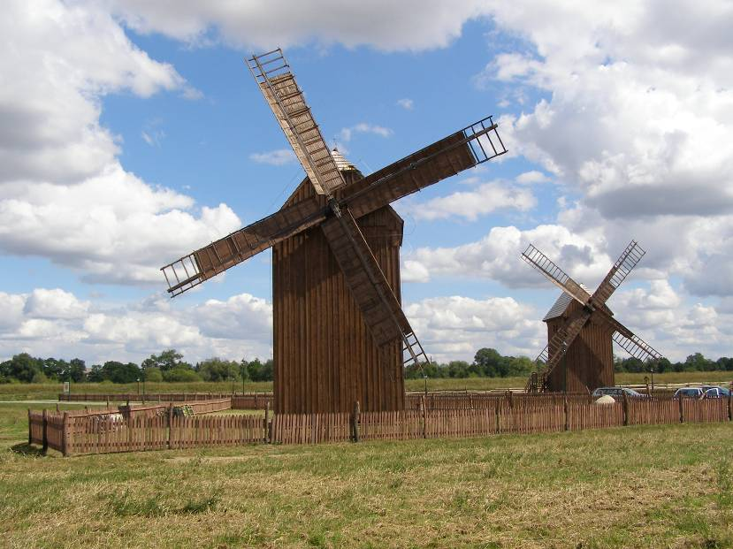
Windmills in Poland
and the world of Polish traditional milling
Online International Conference on the Craft of the Miller
5 November 2020
Filip Tomaszewski
Assistant Profesor, Institute of Architecture and Urban Planning,
Lodz University of Technology, Poland

Slide 2
Facts & figures on windmills in Poland Today: - 65 windmills in open – air museums (43 post mills, 12 Dutch mills, 10 paltrok mills) - 254 windmills in the Register of Historical Monuments (most of them – 88 in Greater Poland) - around 60 windmills (in situ) which were restored in the last 20 years and which are in good technical condition - 0 every – day working windmills (last working windmill was the windmill in Chlebczyn /Mazovia/ which worked until 1985) - around 10 windmills which work occasionally (in situ and in museums) Formerly: 6360 – the number of windmills in Poland before the World War II 867 – the number of windmills in Poland in 1959/60 (borders has changed after WWII), must be treated as an estimation

Slide 3
Facts & figures on working mills in Poland Today: - around 500 working mills - around 100 big mills (with efficiency = 200 – 300 tons a day) - they provide 90% of the flour on the market Small mills (up to 30 tons a day) cannot compete with large ones when it comes to basic flours, therefore they make special flour, including wholemeal flour. A small mill, if it finds a market niche, can function

Slide 4
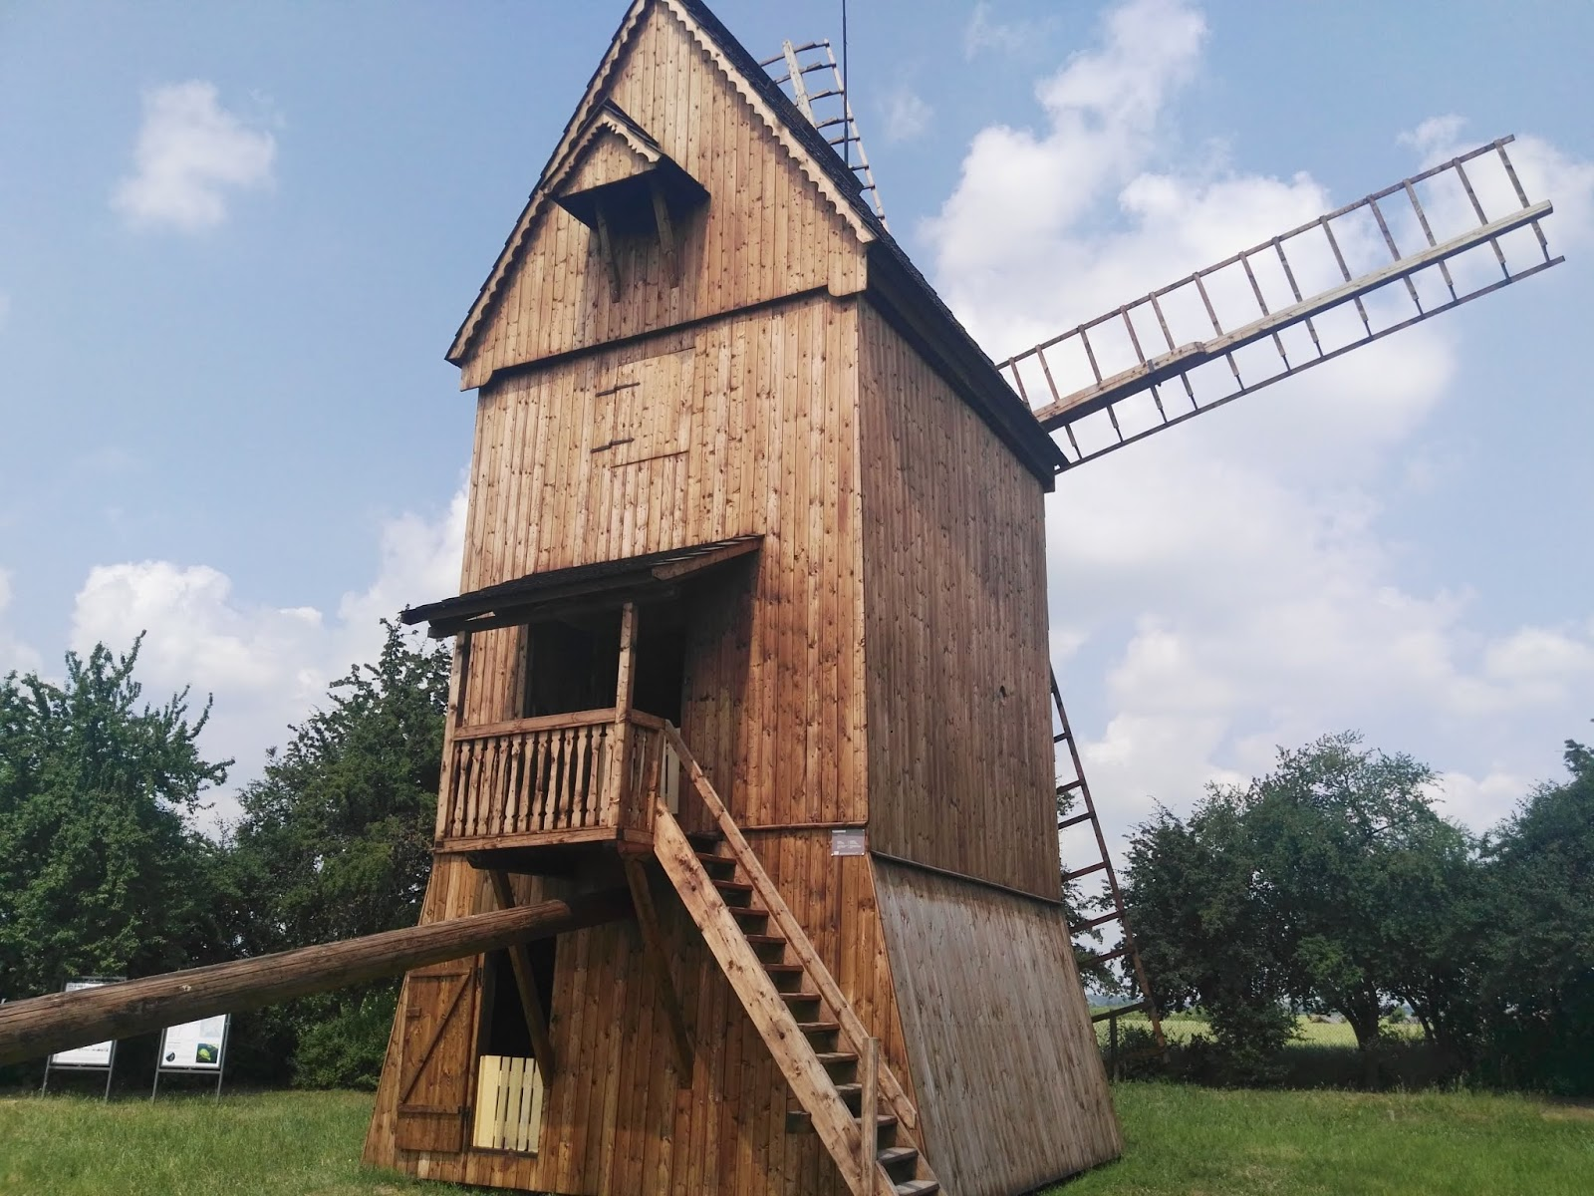
The oldest windmill in Poland located in the Museum of the First Piasts in Lednica, in the so-called a small open-air museum – post windmill from Gryżyna, 1585 fot. Marzena Sikora

Slide 5
Mills organisations in Poland
Polish Association of Employers of the Grain and Milling Industry (fomer Association of Millers of the Republic of Poland) - associates milling companies, not persons, engaged in contemporary milling
Polish Molinological Association – associates enthusiasts of old mills and traditional milling

Slide 6
Government involvement in traditional milling
No programs aimed only at supporting traditional milling
Subsidies related to the monument protection system
Museum financing system - open-air museums are financed by voivodeship self-governments

Slide 7
Millers' problems passing on the craft of the miller to future generations
There are no schools to educate professional millers (future millers are trained just in mills) – this problem concerns modern milling
In traditional mills there are occasional training sessions for amateurs, students and children
Most museums (with mills) organize workshops connected with traditional milling
There are many organizational problems with keeping windmills in operation (it concerns most of open-air museums)

Slide 8
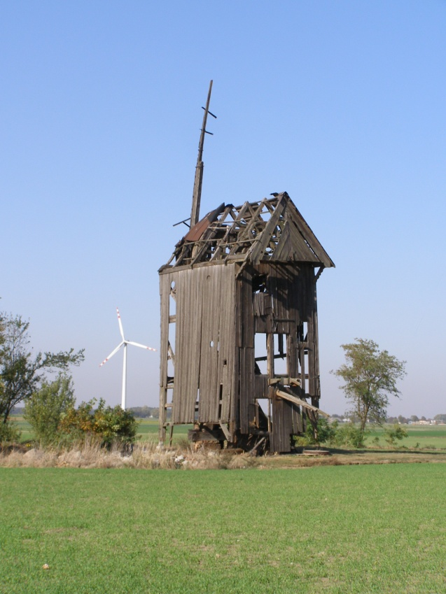
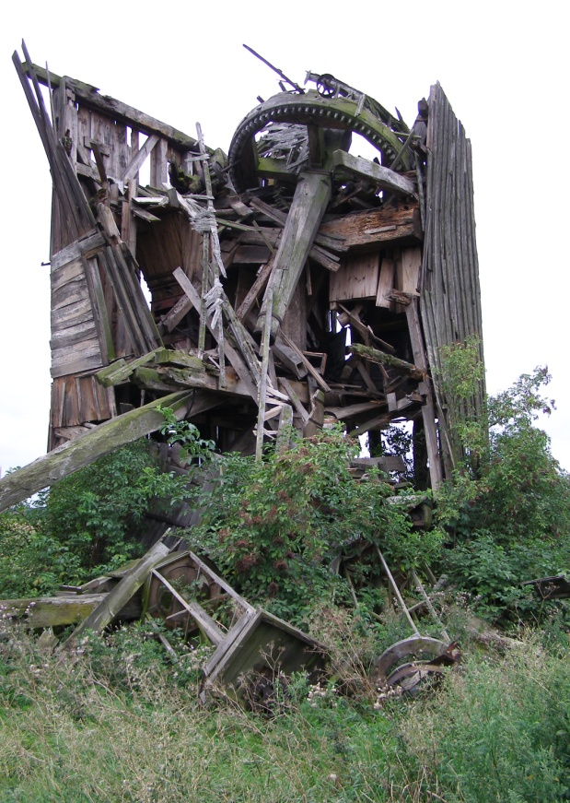
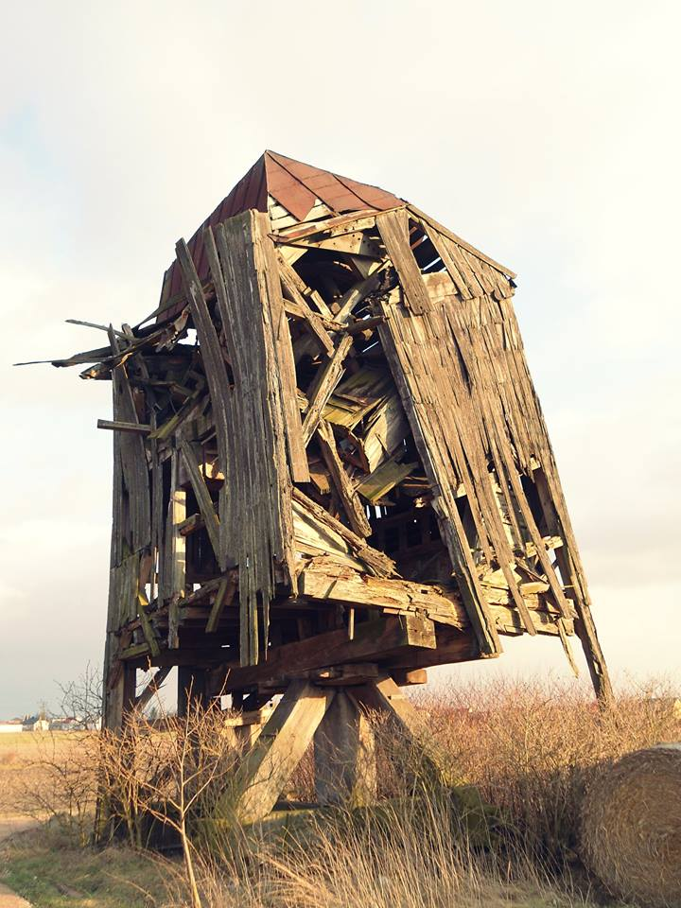
Examples of windmills in Poland
The last preserved „in situ” objects disappear
Szamarzewo, near Września
15.10.2018
Kotków, near Łęczyca
10.08.2012
Tarnówka, near Koło
2015 (fot. Z. Nuszkiewicz)

Slide 9
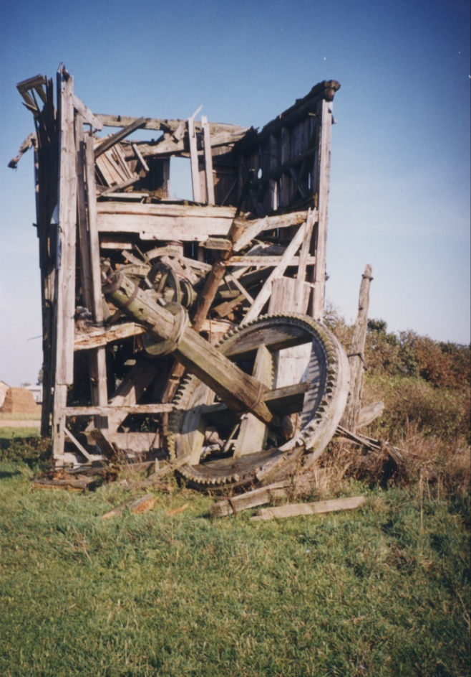
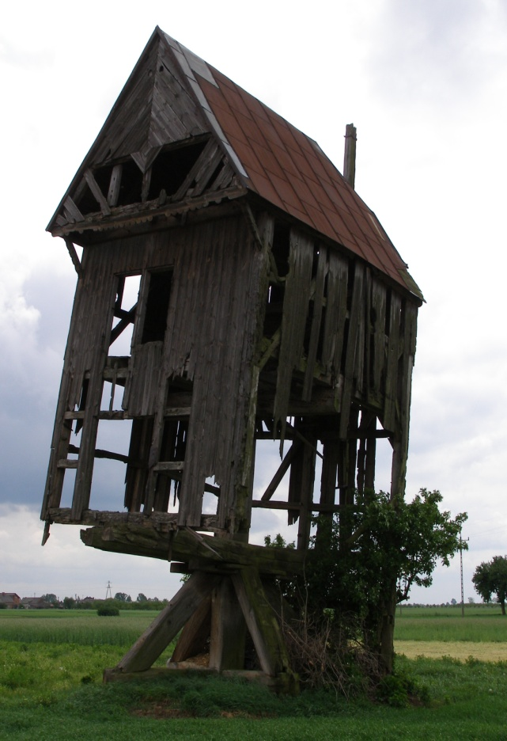
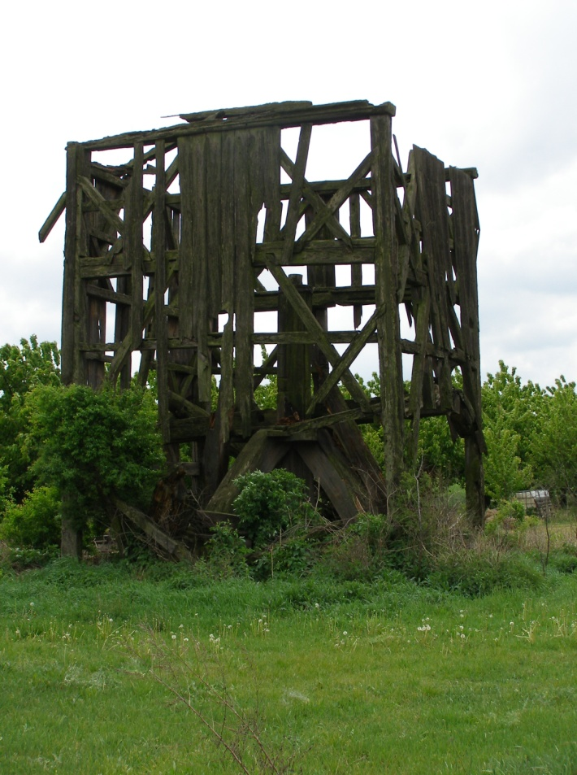
Brodnia, near Poddębice
10.2001
Rataje, near Września
15.05.2011
Pyzdry, near Września
15.05.2011

Slide 10
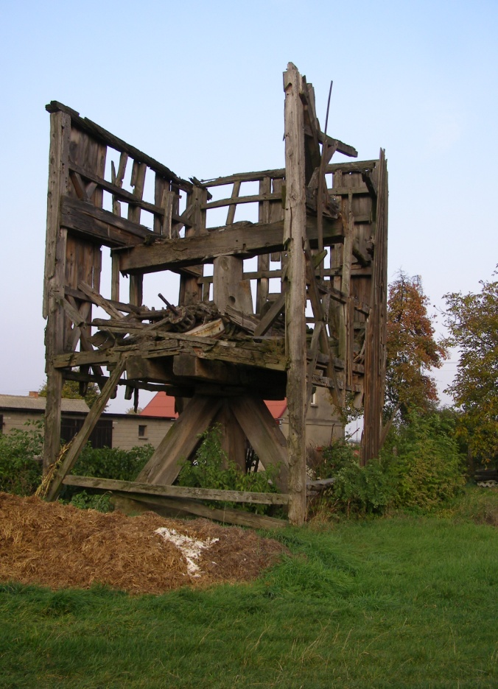
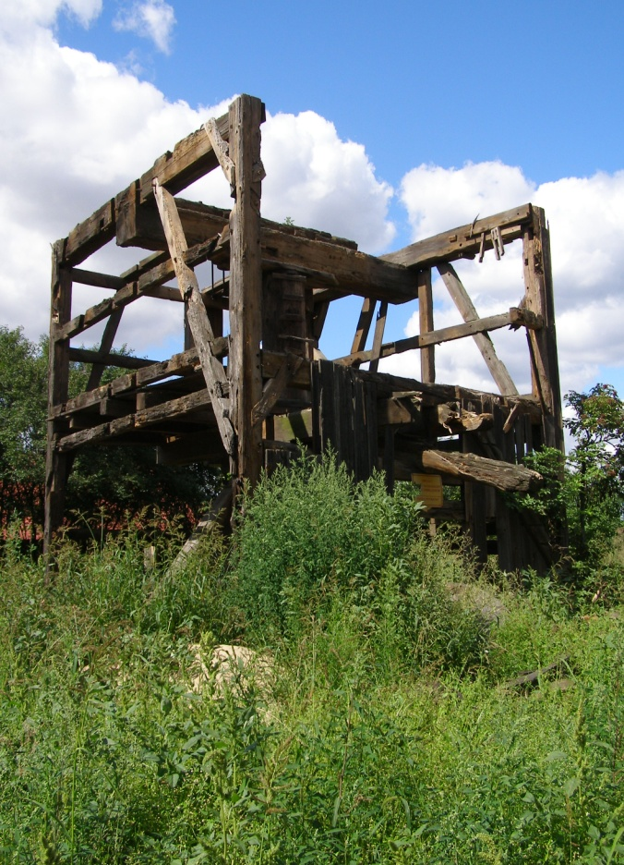
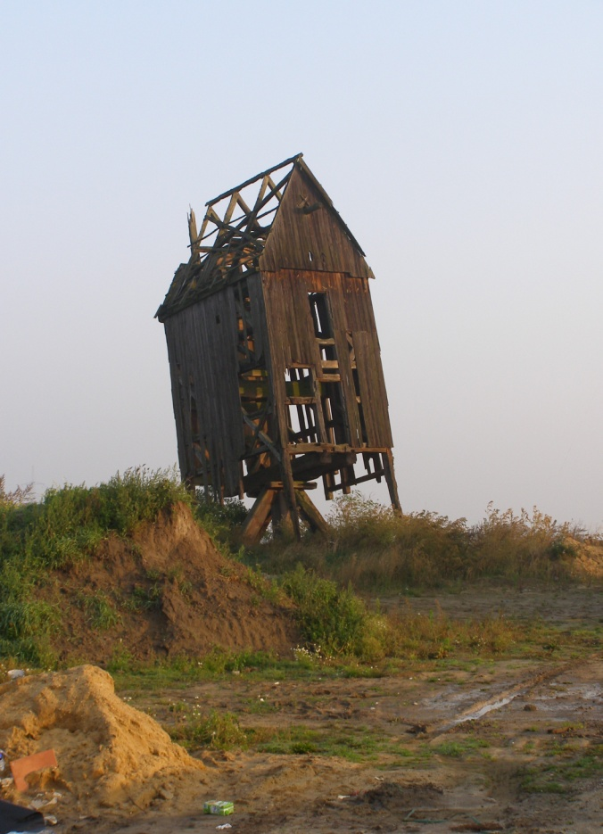
Skulsk, near Konin
09.10.2013
Powidz, near Słupca
08.2016
Wilkowice, near Leszno
02.10.2010

Slide 11
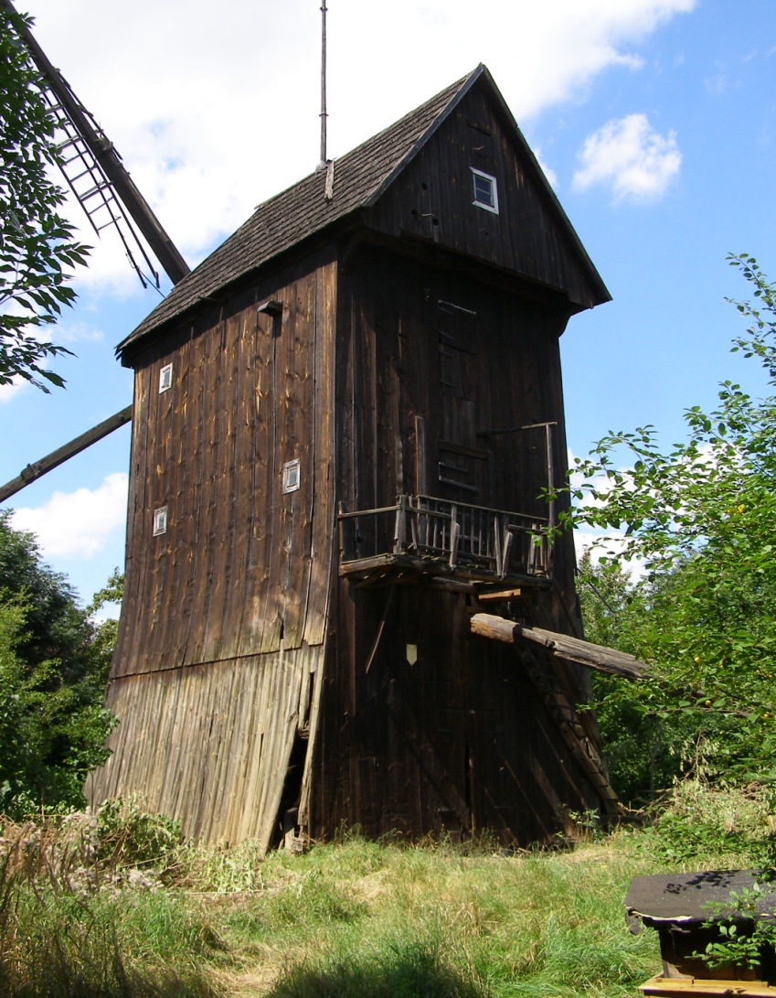
Fortunately there are many positive examples - here is one of them:
translocation and renovation of the windmill in Leszno
The windmill in Leszno from 1728 before translocation
(Strumykowa street - 08.2017 r.)

Slide 12
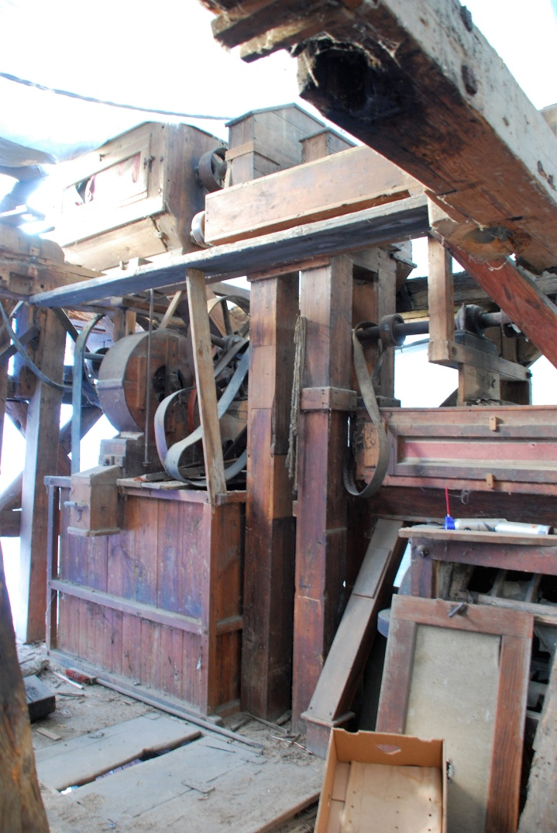
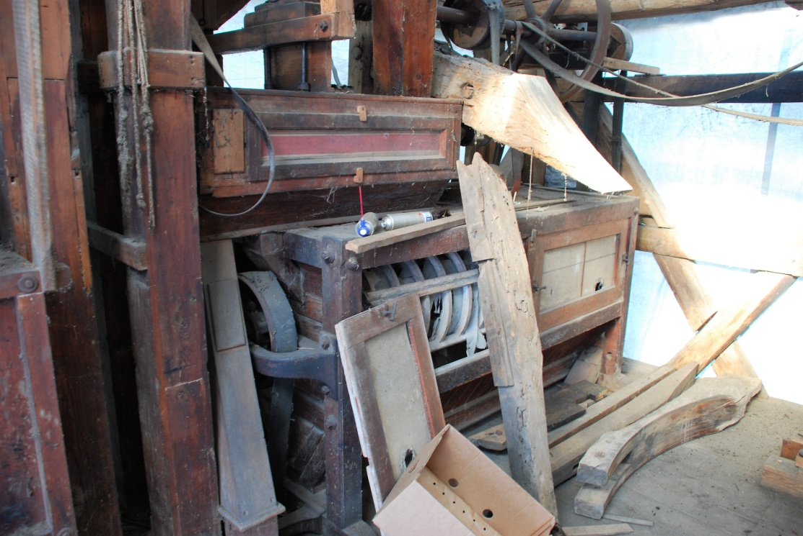
Equipment of the Leszno windmill during demolition / disassembly (June 2018). Photo J. Jankowski

Slide 13
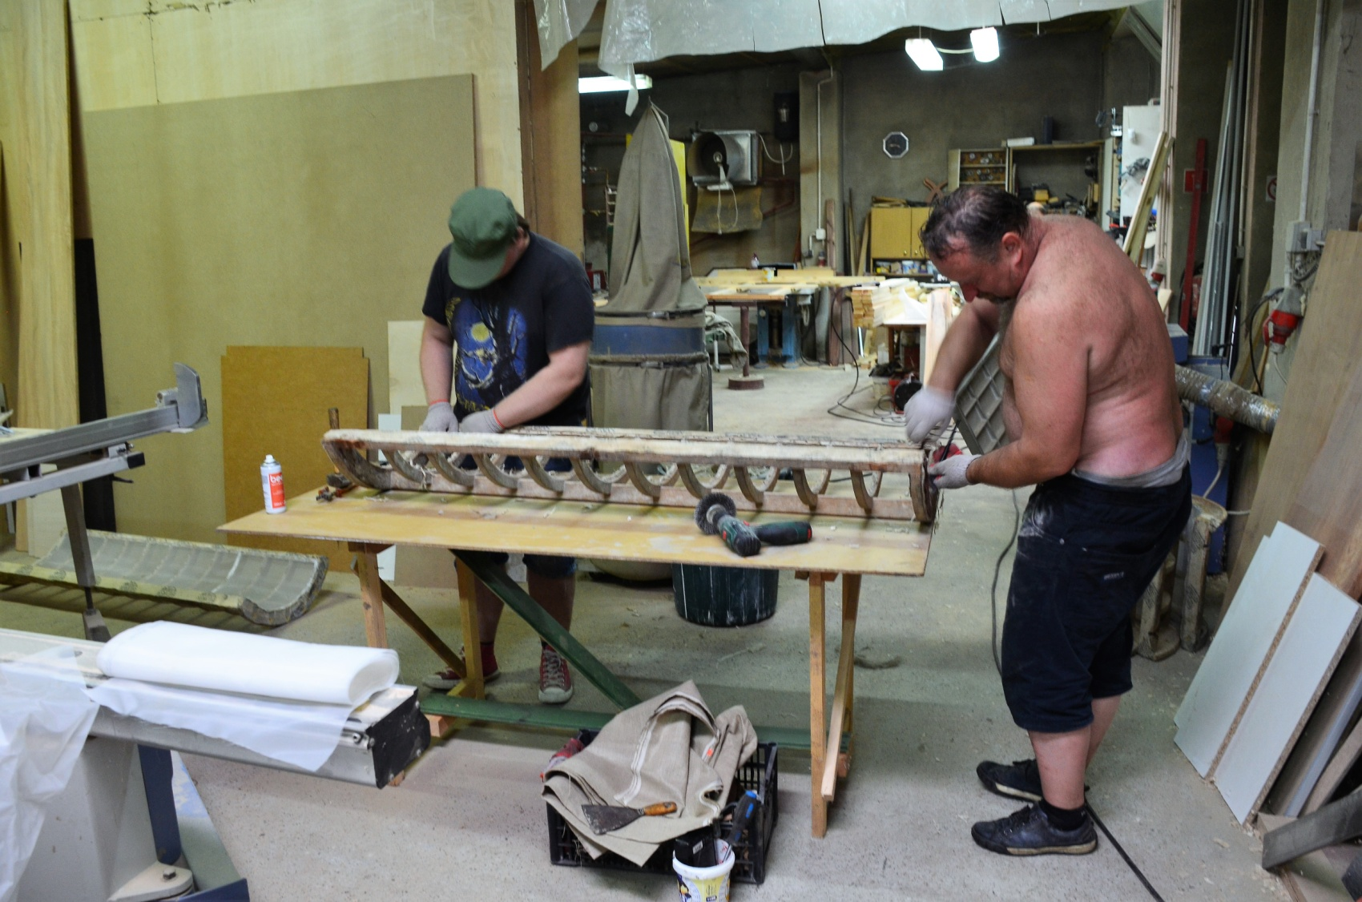
A few shots of renovation works related to the windmill equipment.
Photo J. Jankowski

Slide 14
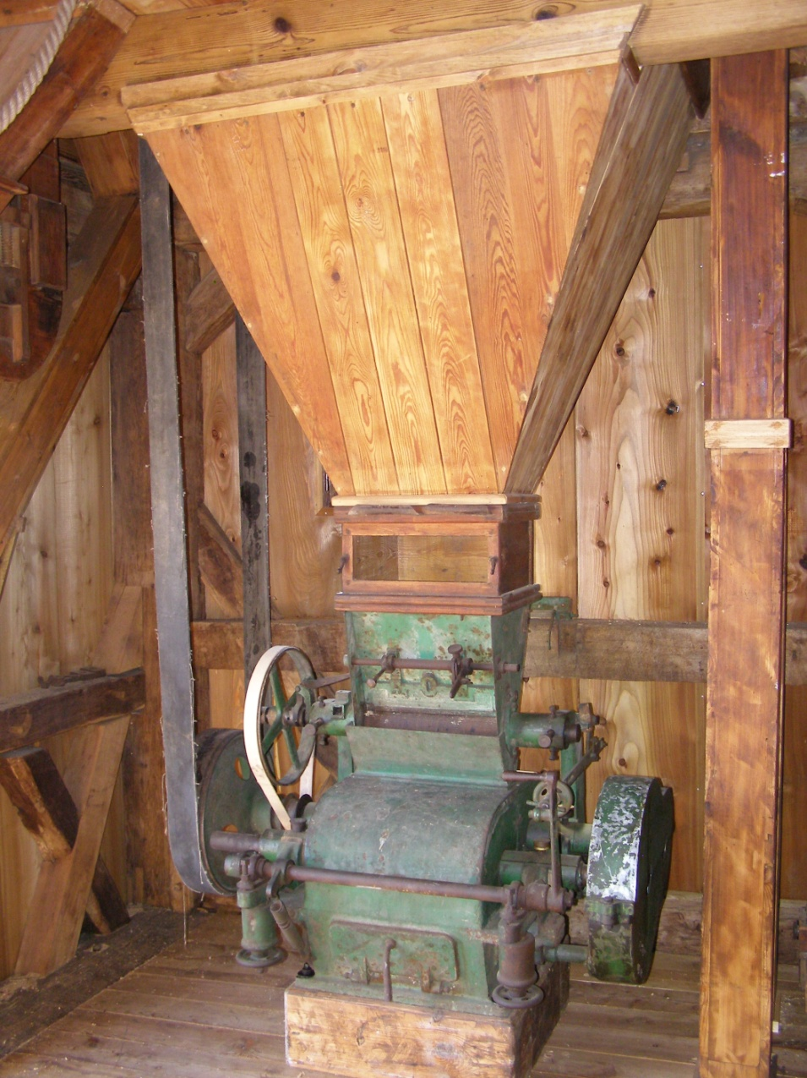
Roller mill in the windmill in Leszno (20/09/2018). Photo F. Tomaszewski

Slide 15
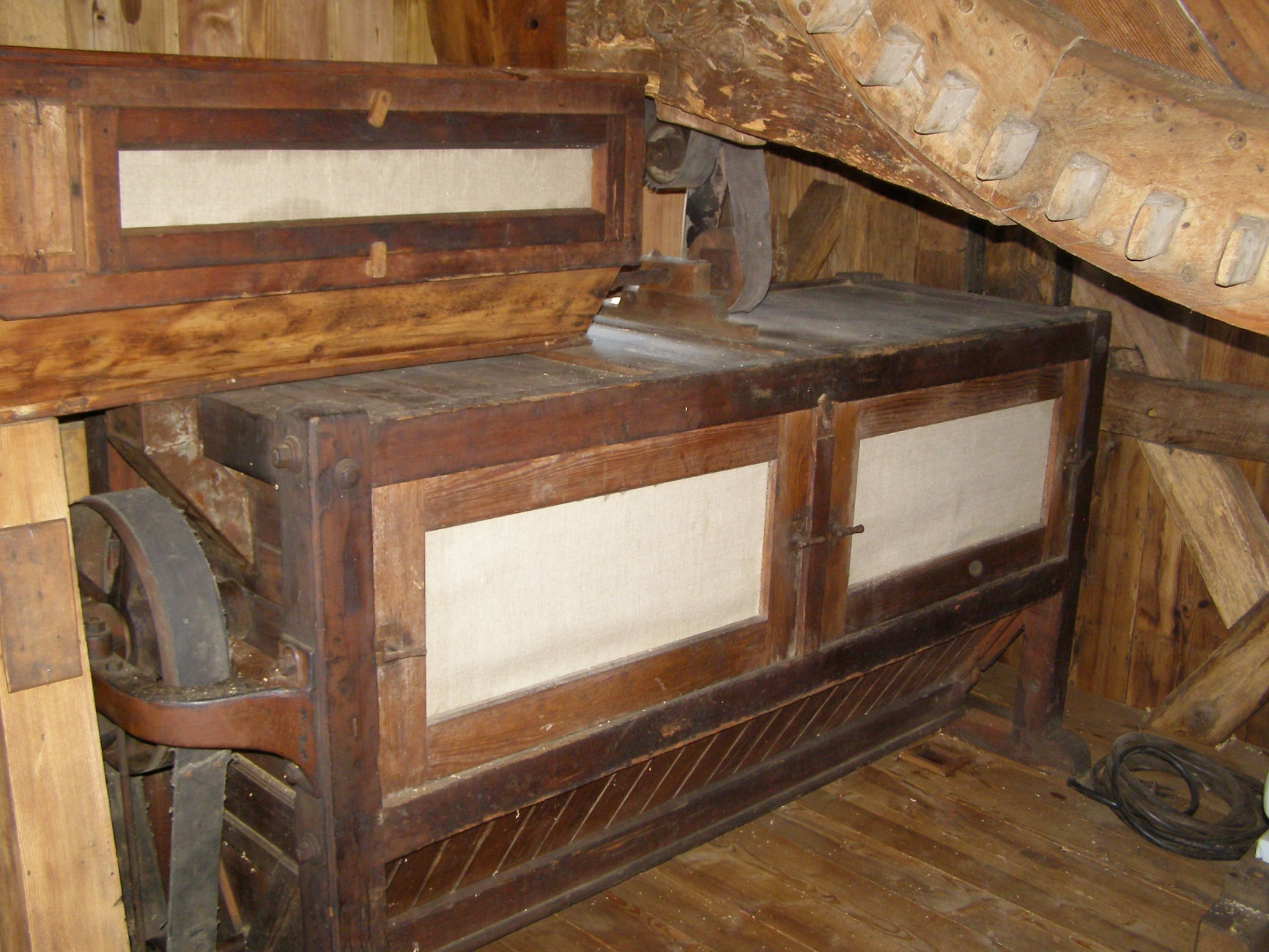
Sifters at the windmill in Leszno (17/09/2018). Photo F. Tomaszewski

Slide 16
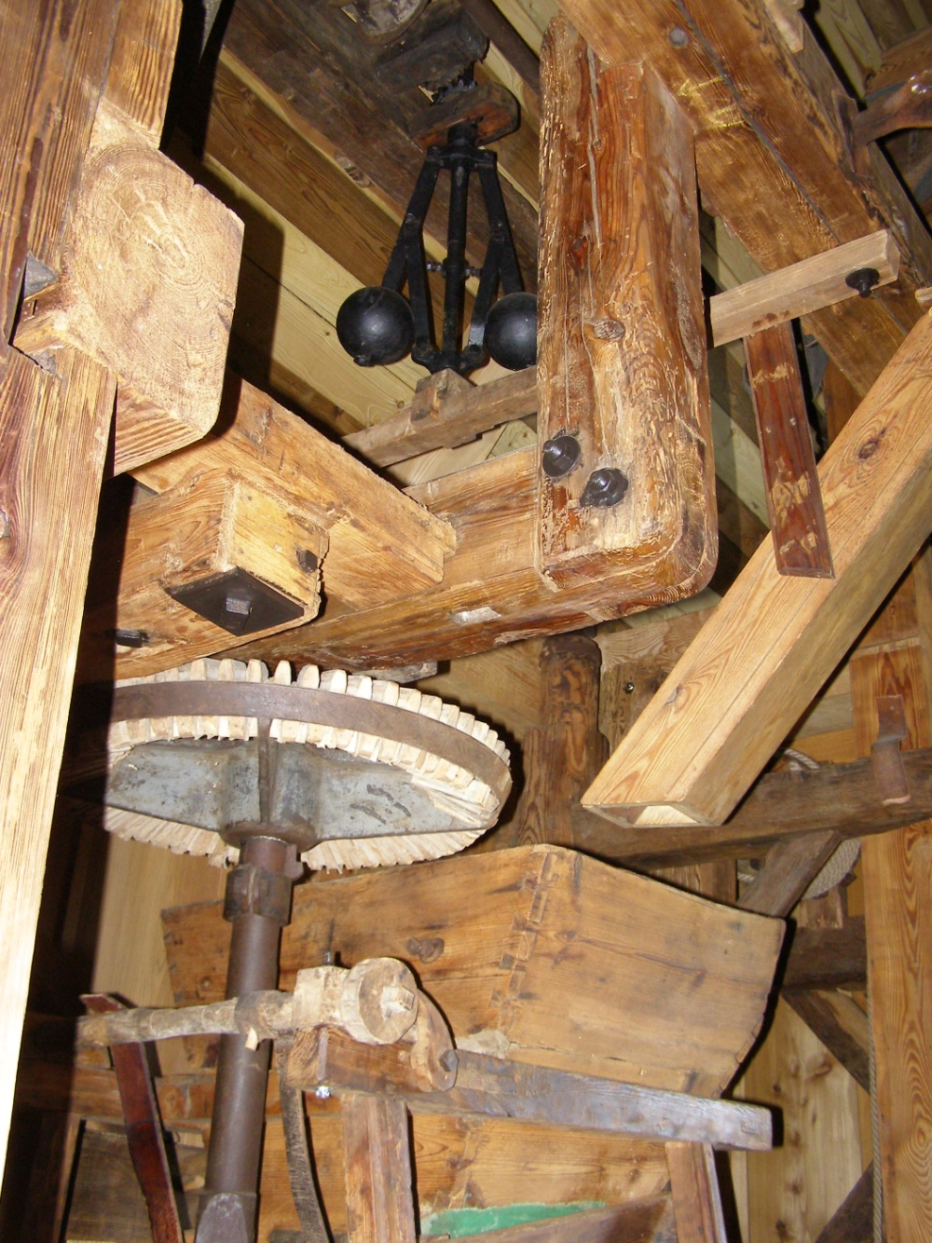
The gear that drives the millstones in the windmill in Leszno (17/09/2018).
Photo F. Tomaszewski

Slide 17
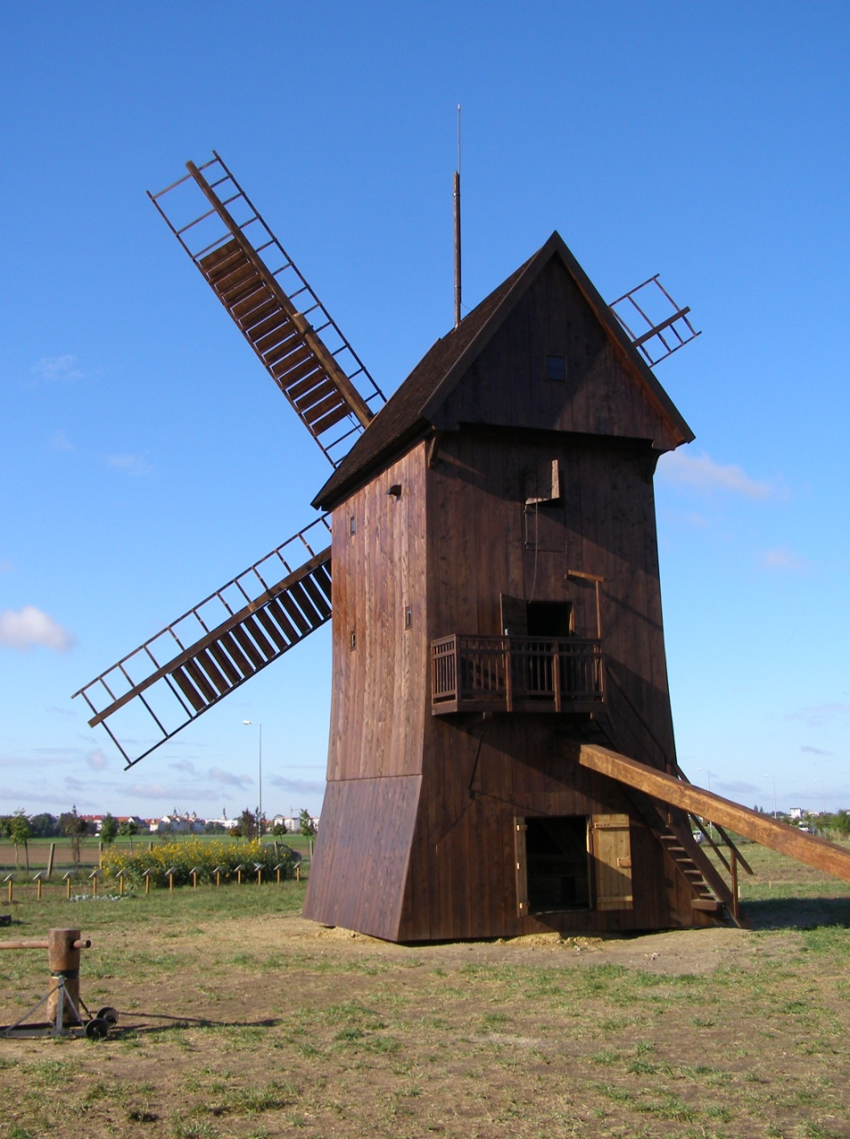
Windmill in Leszno after renovation (September 25, 2018). Photo F. Tomaszewski

