Slide 1
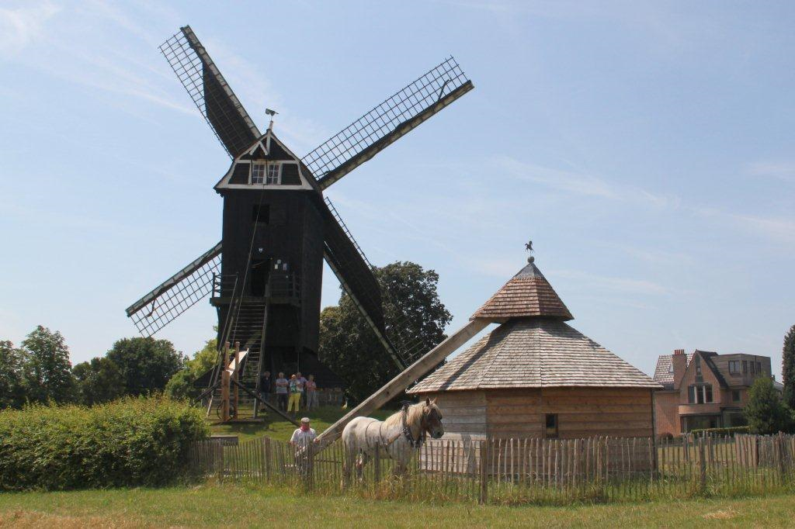
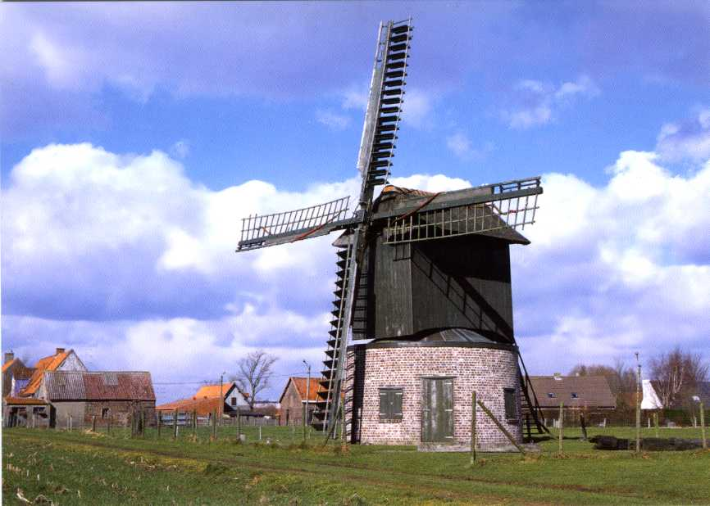
Facts and figures
Flanders and Brussels
± 100 operational watermills (some of them producing green power)
± 150 operational wind-powered mills (post and tower mills)
- 12 horse mills
1 tide mill
2 polder windmills
12 oil-producing mills
1 saw (water) mill
1 (rare) flax mill
± 500 non operational mills

Slide 2
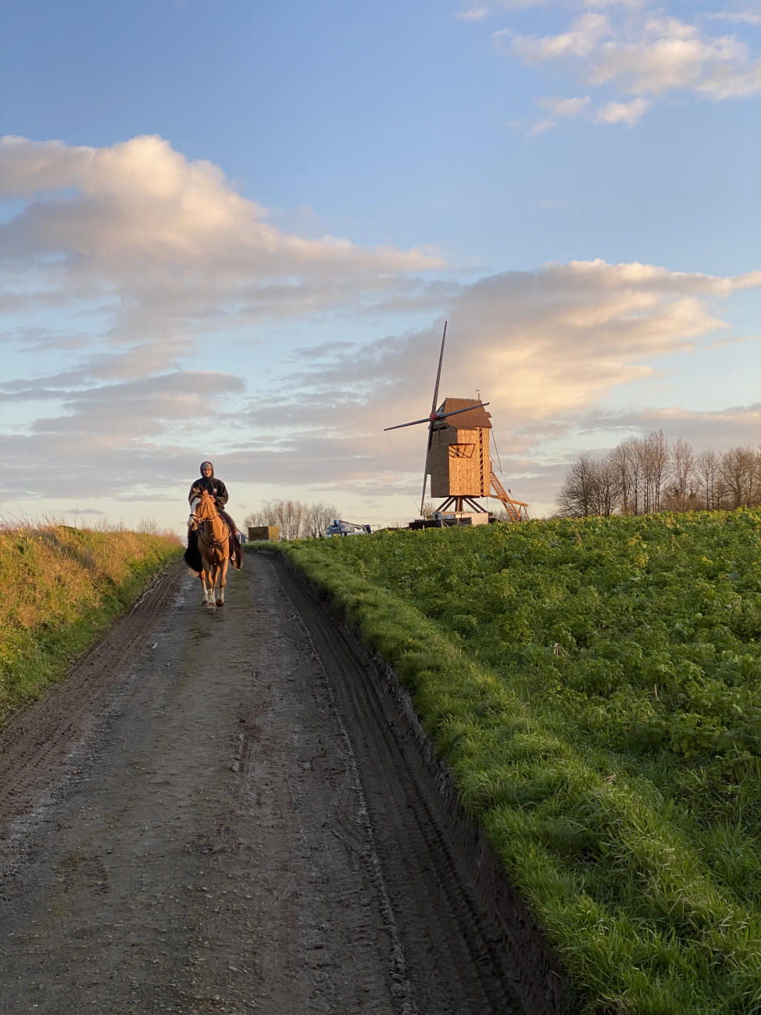
Facts and figures
French-speaking part of Belgium
Only a few operational water and windmills.
Local initiatives. No umbrella organization.

Slide 3
Umbrella mill associations in Flanders Advisory bodies Molenforum Vlaanderen deals with mill-related topics and discusses them with the competent tangible/immovable heritage institute Levende Molens

Slide 4
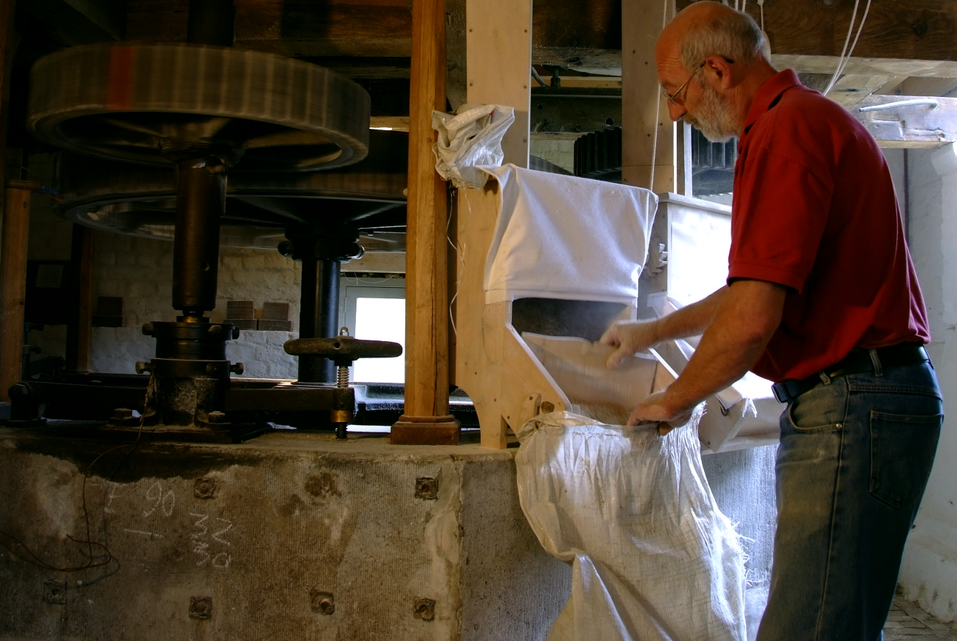
Millers
About 1,000 (trained) voluntary millers
4 professional millers

Slide 5
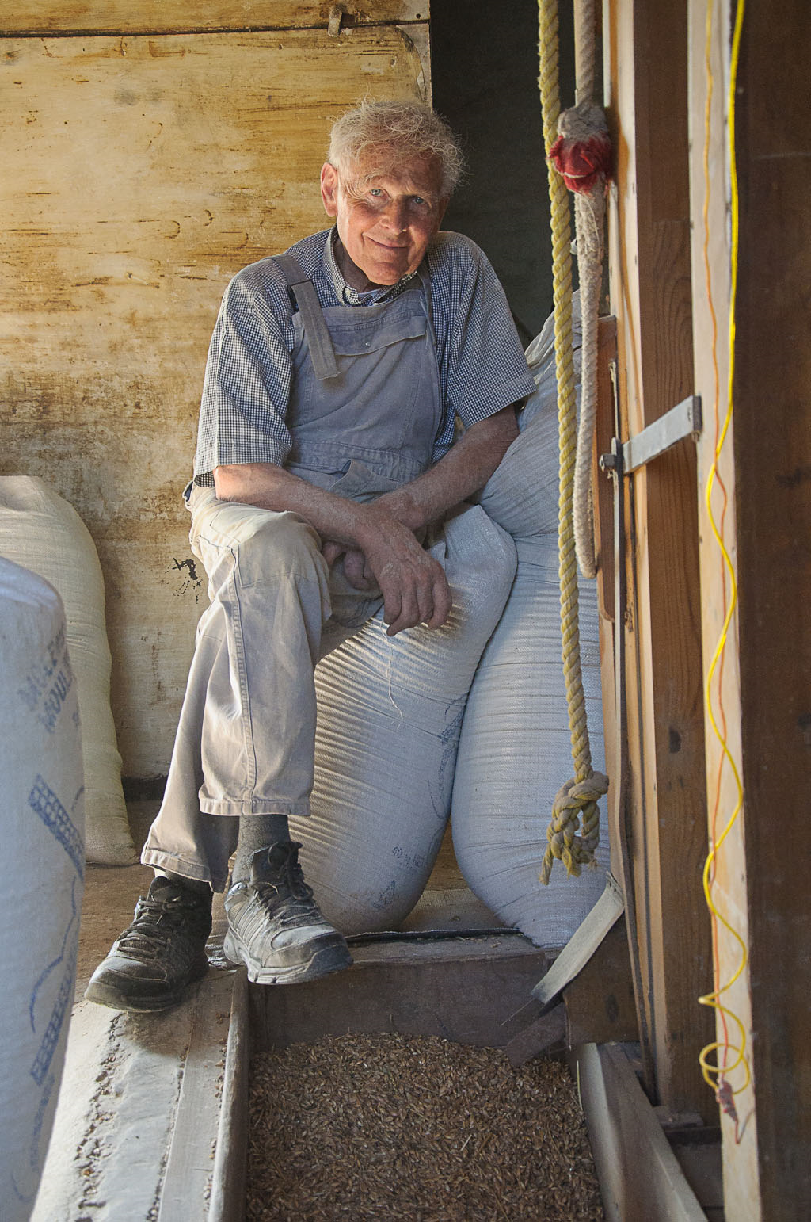
Recognition of the Craft of the Miller
Also in Flanders
(voluntary) millers hand their skills and traditions down to the next generation (since 1970)
The National Food and Drug Organization authorizes the trade in foodstuffs produced by millers

Slide 6
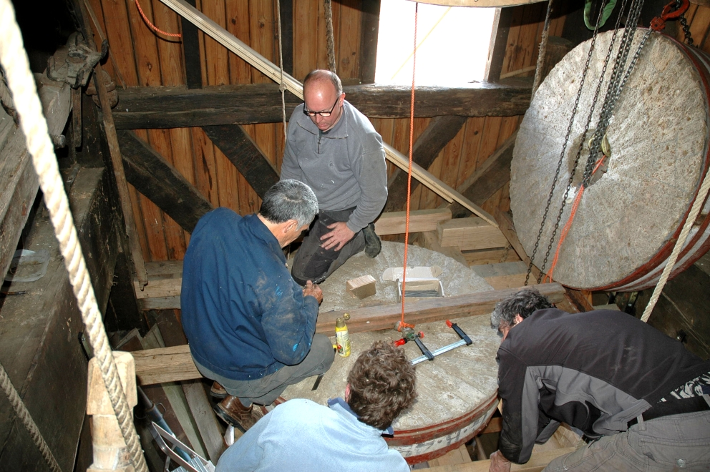
Mill preservation =
֍ maintenance (teamwork)
֍ train new millers
֍ mill days
֍ selling flour, oil…

Slide 7
Government involvement subsidizes restoration and maintenance work: ± 60% highly complex organization of the State → confusing separation between authorities in charge of intangible and those responsible for tangible heritage! In addition: their rules change too often No consistent long-term policy

Slide 8
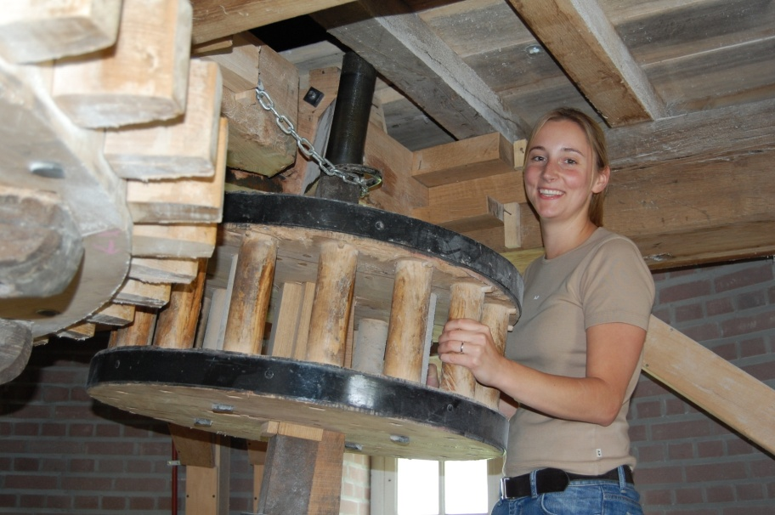
Training ֍ increase in the number of participants in the millers’ course: ± 100 every 2 years ֍ topics: history, craft of the miller, safety, mill functions, cereals, weather forecast, folklore... ֍ more focus on “enthusiasm” ֍ training of guides (educational guidance for children, adults).

Slide 9
Training
10 theoretical sessions + visit to mills
100 hours of practical training focusing on several types of mills (2 years)
special training days
theoretical exam
(multiple choice)
practical exam
(including grain grinding/
oil pressing test)

Slide 10
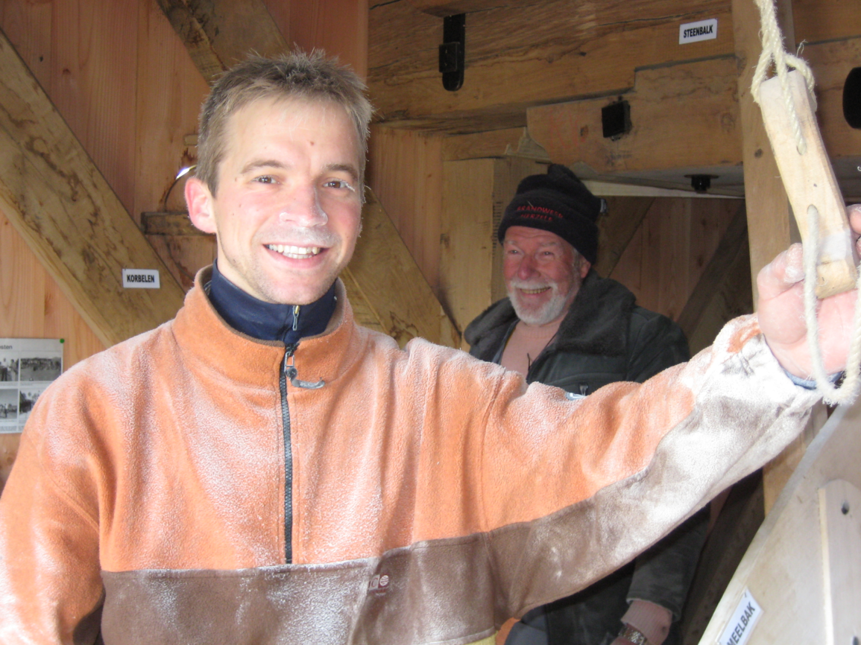
Issues/objectives
need for more
(experienced) instructors
“master-miller” at the end of the training = qualification referring to the medieval
master-journeyman training system
better follow-up of people who passed the exams
focus on the Flemish roots of windmills

